Slide 1
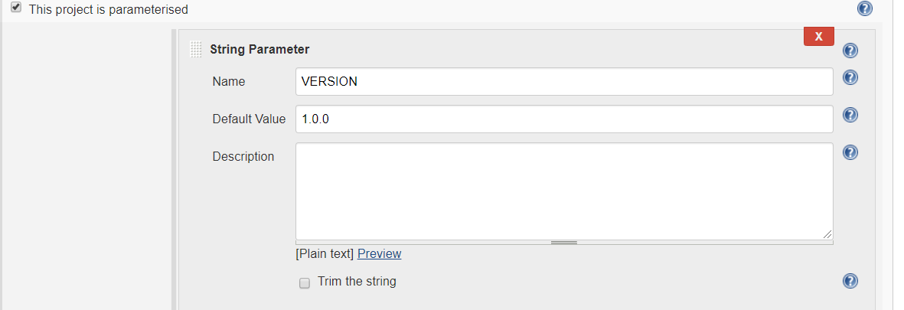

Slide 2
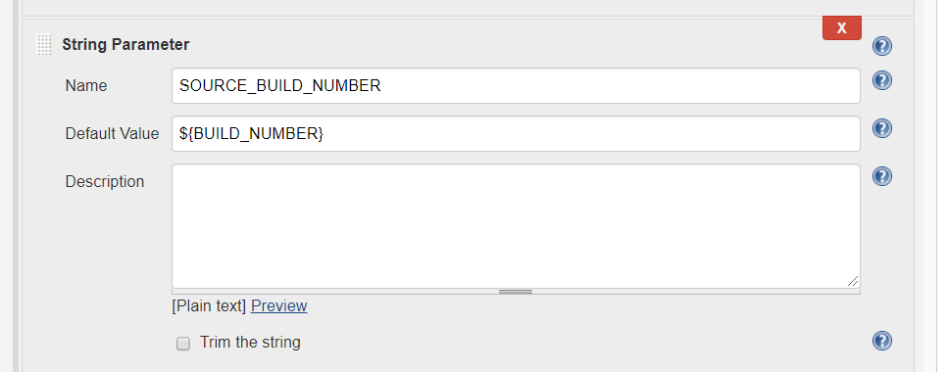

Slide 3
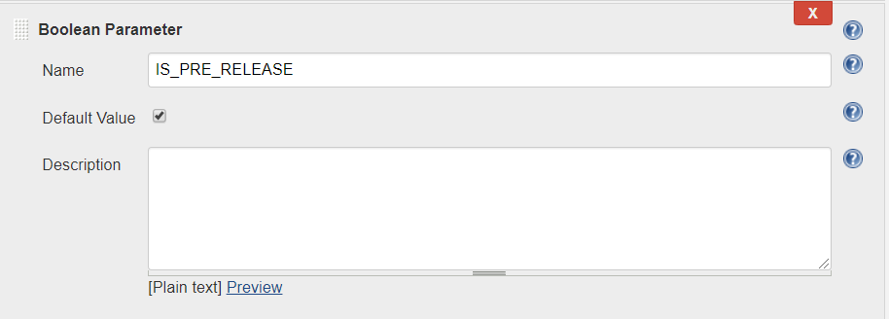

Slide 4
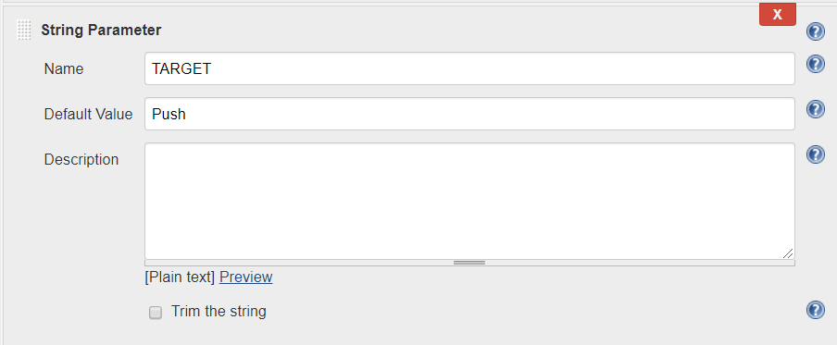

Slide 5
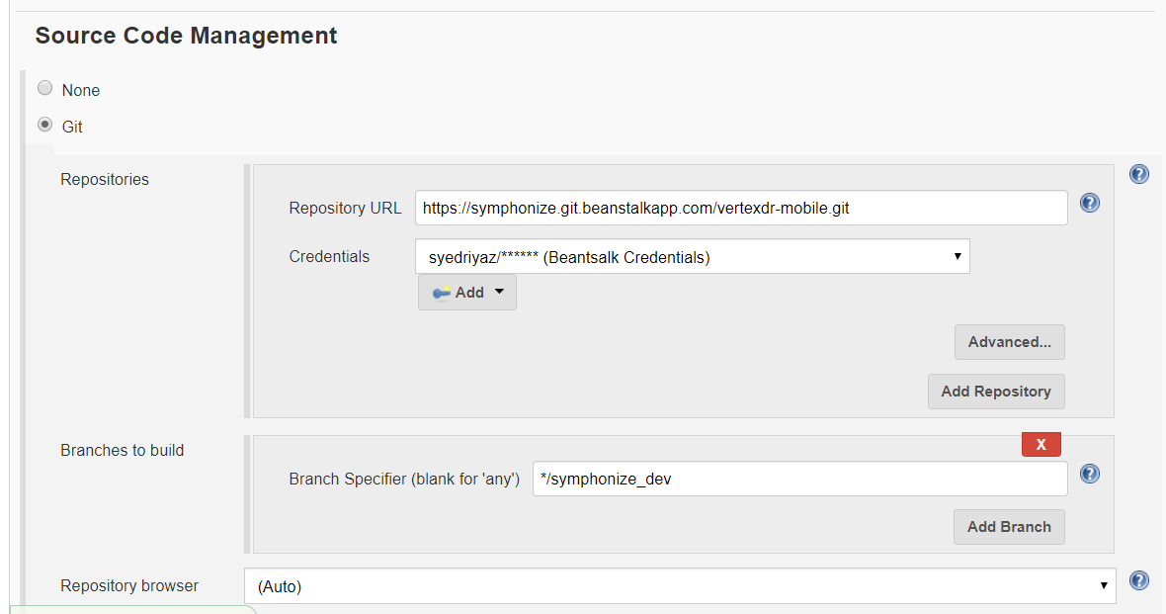

Slide 6
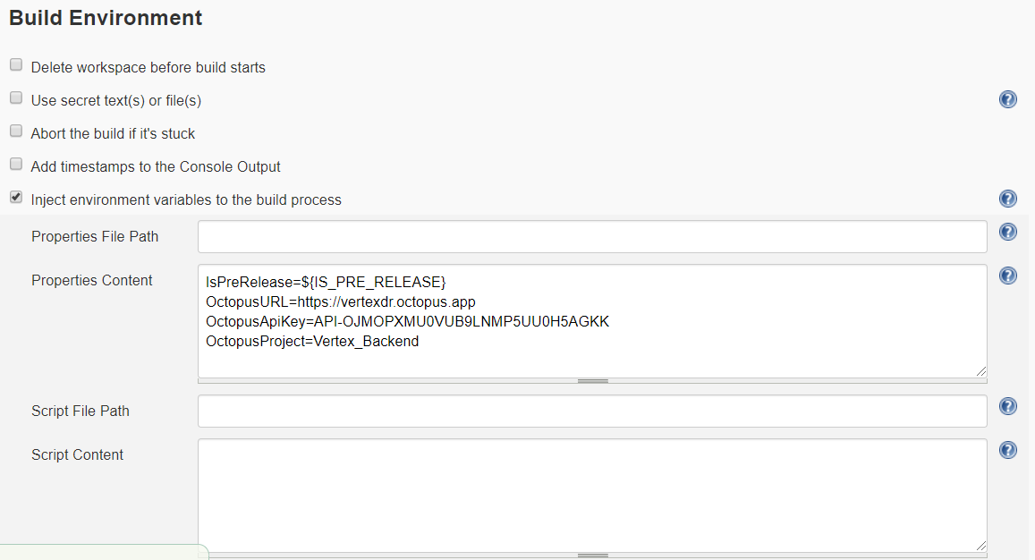

Slide 7
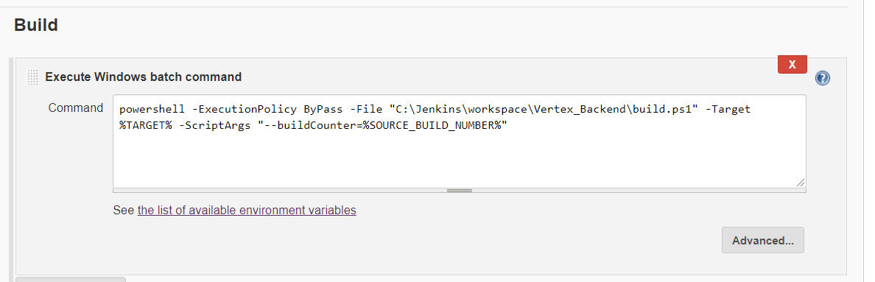

Slide 8
powershell -ExecutionPolicy ByPass -File "C:\Jenkins\workspace\Vertex_Backend\build.ps1" -Target %TARGET% -ScriptArgs "--buildCounter=%SOURCE_BUILD_NUMBER%"

